Slide 1
CAMPUS NETWORK DESIGN MODULE
- SAKSHAM THAREJA (RA1911031010065)
- AKARSHIT VATS (RA1911031010066)
- SAKSHIL VERMA (RA1911031010071)

Slide 2
ABSTRACT
A “CAMPUS NETWORK DESIGN MODULE” is a type of network that is designed for establishing the Internet network in the campus. It is a project which can be usefully established for the network in any college or campus. In this project, we used the Cisco Packet Tracer software for designing the network module. This project is implemented in the software using real-time simulation that confirms live data transfer is working or not. We have project on Campus Network Module that will help network designing have an edge over others when it comes to cost and product designing. The study provides an insight into various concepts such as topology design, IP address configuration and how to send information in form of packets in a single network and the use of Virtual Local Area Networks (VLANs) to separate the traffic generated by different departments.

Slide 3
Introduction
The need for computer networking was borne out of the need to use personal computers for sharing information within an organization in form of messages, sharing files and data bases and so forth. Whether the organization is located in one building or spread over a large campus, the need for networking the computers cannot be over emphasized. As the name implies, a Local Area Network (LAN) interconnects computers in a limited geographic area. It provides high-bandwidth communication over inexpensive transmission media.
The main purpose of a network is to reduce isolated users and workgroups. All systems should be capable of communicating with others and should provide desired information. Additionally, physical systems and devices should be able to maintain and provide satisfactory performance, reliability and security.
In this project, we designed this project in Cisco Packet Tracer using Servers, Routers, PCs, Laptops, Wireless Routers(WIFI campus), etc and for the connection purposes we have used the optic fibre cables and copper cables for the best efficiency in network purpose. This project is developed for the college campus taking in consideration the phases like main building, library, hostels, etc.

Slide 4
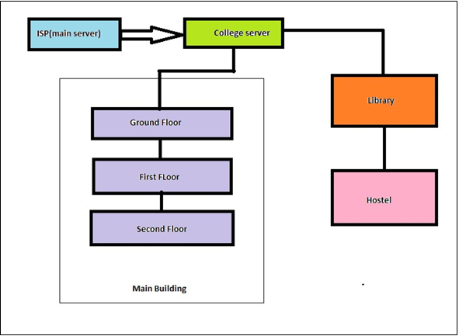
METHODOLOGY
First we design our project then we implemented it. In starting, we have the main ISP Server that provides the main internet line to the college, further it is given to the college server that is data center from where the connections to the whole campus are provided.
One line is given for the main building in which series router connections (Bus Topology) are provided for the different floor connections which are further extended to the star topology for connections at different labs and offices.
The second line from the college server (data center) is provided to the library which is further extended to the hostel.
Again the star topology is implemented in the hostel for wireless connections(WIFI).

Slide 5
PROPOSED WORK AND SIMULATION
The various sub-parts of the network are :
ISP (Main-service provider)
Data-Centre (College server)
Floor plan (Main building floors)
Library
Hostel
Whole campus

Slide 6
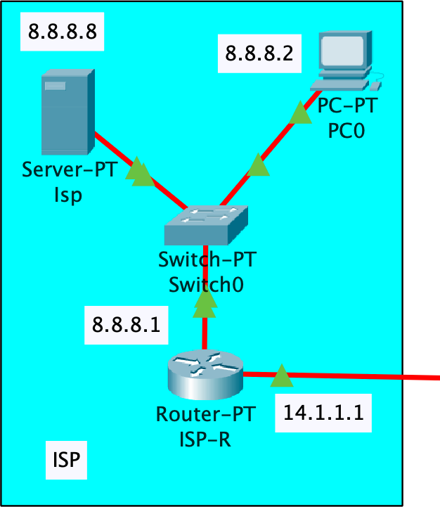
ISP (Main-service provider)
From the fig we can see that the main internet service provider (8.8.8.8) is implemented and its connection is given to switch extended to the router which is further passed to the college server (datacenter). The default gateway here is 8.8.8.1.

Slide 7
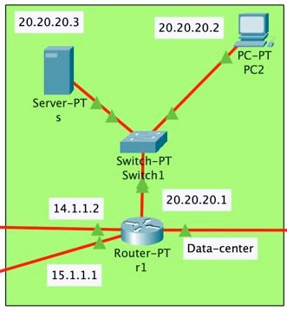
Data-Centre (College server)
From the fig. we can see the college server, that is data-center from where the internet service is provided to whole college. The college server has ip 20.20.20.3, whose further connection is given to the router (IP: 20.20.20.1) through a switch. From this router connections to the main building that is to all floors and lab in the college is provided and library and hostel is provided.
A separate pc with ip 20.20.20.2 is provided for any network connections problems diagnostics in the campus.

Slide 8
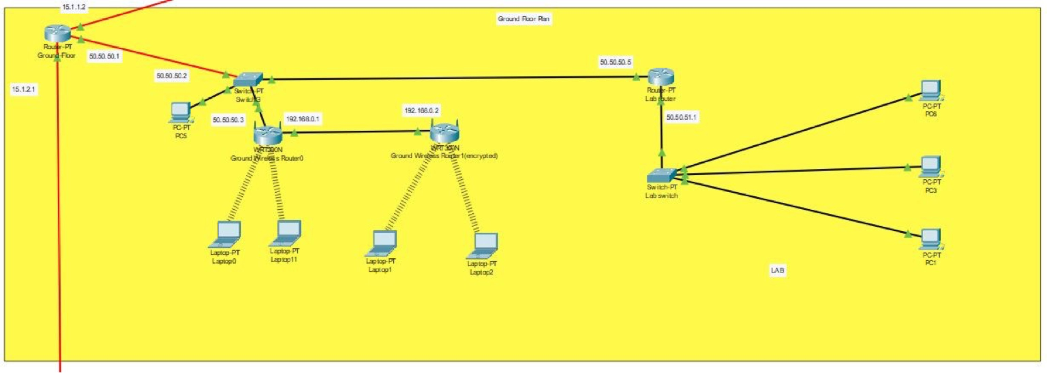
Floor plan (Main building floors)
The router (ip:15.1.1.2) provide the connection to whole floor, whose connection is given through a switch to the further routers for the labs and wireless routers for the WIFI purpose. The wireless routers are provided with the service of encryption so that with proper authentication one would not be able to access the internet service.

Slide 9
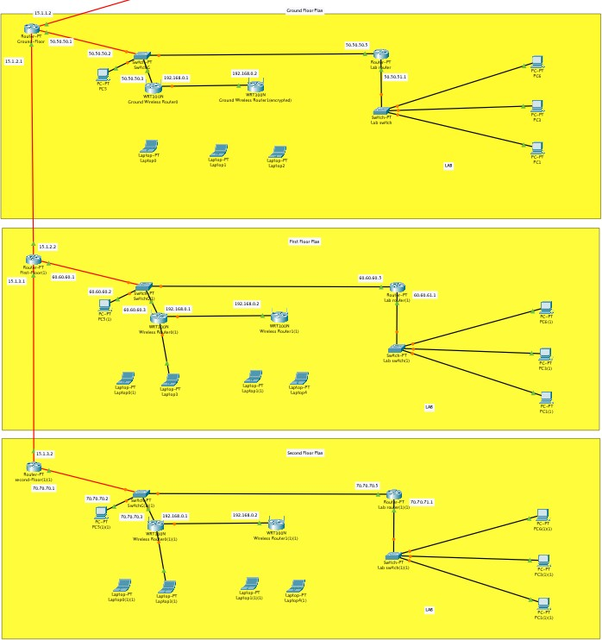
This figure shows the connection of routers in the main building for internet connection, we can see that the routers are connected serially i.e the bus topology is implemented for the floor to floor connection and further the star topology through the switch for wireless routers and lab routers.

Slide 10
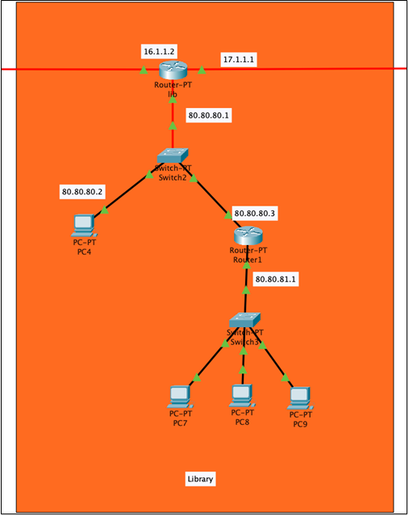
Library
The net connection comes to the router (ip:16.1.1.2) from which the further connections are provided using a switch in which again the star topology is implemented.

Slide 11
Hostel
The figure shows the network implementation for the hostel. The router with ip 17.1.1.2 is the main router here from where the further connections are provided to the routers using a switch. Again here the star topology is implemented for the wireless routers through a switch .
From fig we can see that a separate pc and router is provided for the office from which the floor to floor connections are provided using the switch. And the wireless routers are connected serially on the floor which shows that the bus topology is implemented here.

Slide 12
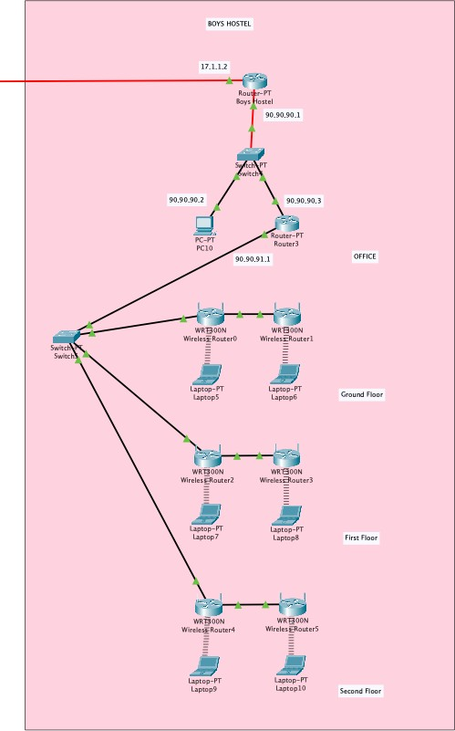

Slide 13
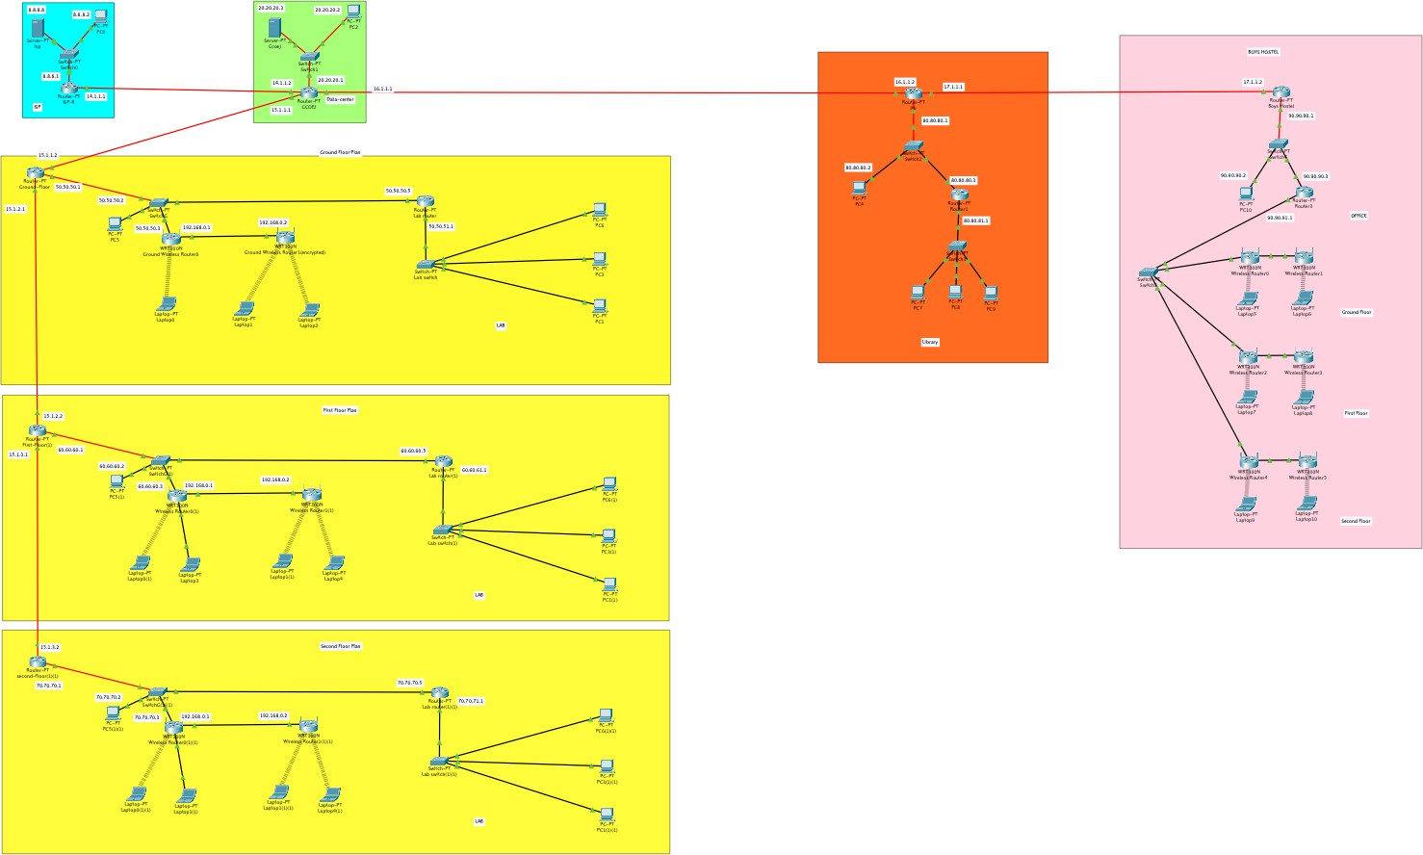
Whole campus

Slide 14
Configuration/Specifications
The configuration of devices used in designing this project are listed as follows:
Servers - The server type used in this project is the simple PT-Server that has two access ports. For the best efficiency we have changed the port to optic fibre port PT-HOST-NM-1CGE.
Routers - The route type used is simple PT-Router in which also the ports are changed to optic fibre for better efficiency. The wireless routers used are WRT300N for the WIFI network, that provide encryption service.
Switches - In this project simple switches are used i.e PT-Switches that provides 10 ports for accessing the network.
Cables -
Fibre optic cables - The Gigabit Ethernet ports of the Cisco MWR 2941 router can run in full or half duplex mode -100 Mbps or 1000 Mbps (1 Gbps).
Copper cables - Copper straight-through: This is a standard Ethernet cable that is used to connect two devices that operate in different layers of the OSI model (such as hub to router and switch to PC).

Slide 15
TYPES OF TOPOLOGY USED
For interconnectivity of components, network topology describe the physical and logical appearance and interconnection between arrangement of computers, cables and other components in a data communication network and how it can be used for taking a packet from one device and sending it through the network to another device on a different network. A network topology is the physical layout of computers, cables, and other components on a network.
The different types of network topologies are: Bus topology, Star topology, Mesh topology, Ring topology, Hybrid topology and Wireless topology.
A Bus Topology is a network setup in which each computer and network device are connected to a single cable or backbone. Depending on the type of network card used in each computer of the bus topology, a coaxial cable or an RJ-45 network cable is used to connect them together.
The Star Topology is a network topology in which all the clients or machines on the network are connected through a central device known as a hub or switch. Each workstation has a cable that goes from the network card to the hub or switch device. One of the major benefits of the star topology is that a break in the cable causes only the workstation that is connected to the cable to go down, not the entire network as it is with the bus topology.

Slide 16
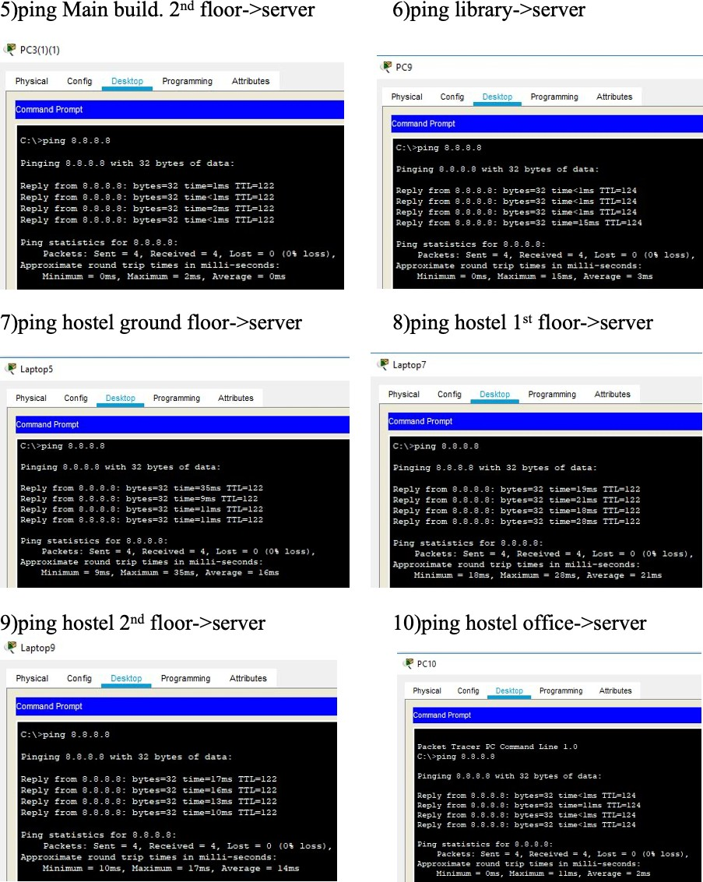
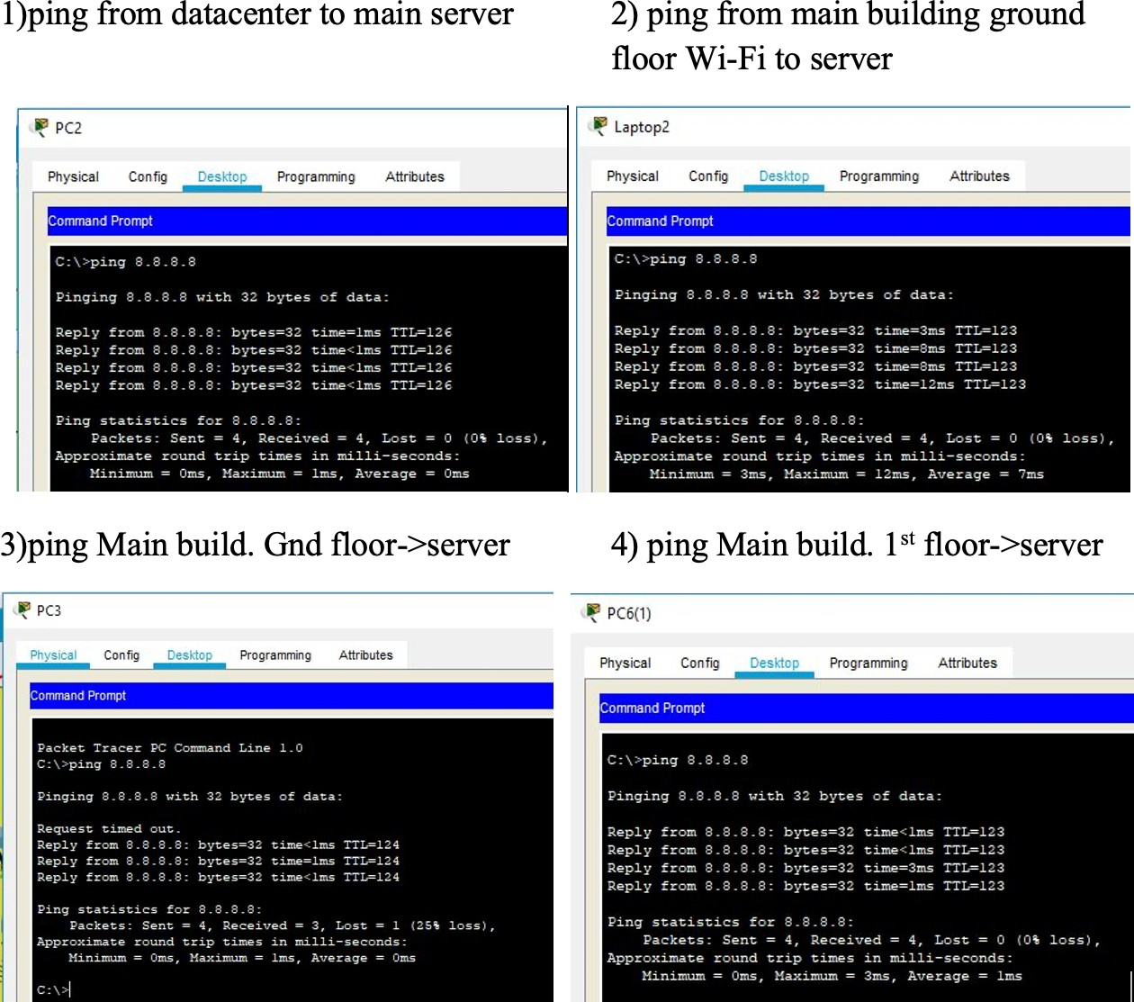
OUTPUTS

Slide 17
Costing for network implementation
1) Data Center
No. of device and quantity are listed below
1. router - 1
2. switch -1
3. server -1
Router price is 72800 Rs
Switch of fiber optic of around 27000 Rs
Server Price in india 150000
fiber optic cable required around 3m cost 60 Rs Fiber optic wire permeter 20Rs
TOTAL COST :- 249860

Slide 18
2) Main Building
Ground Floor
NO. of device and quantity are listed below
1. router -2
2. switch-2
3. wire less router -2
for flooring connect copper wire 50m cost 500Rs Copper wire 10Rs per meter to connect data center to main Building fiber optic wire of 40 meter is used cost 800 Rs
TOTAL COST :- 201300
1ST floor
NO. of device and quantity are listed below
1. router -2
2. switch-2
3. wire less router -2
for flooring connect copper wire 50m cost 500Rs Copper wire 10Rs per meter to connect ground floor to main Building fiber optic wire of 40 meter is used cost 800 Rs
TOTAL COST :- 201300

Slide 19
2nd floor
NO. of device and quantity are listed below
1. router -2
2. switch-2
3. wire less router -2
for flooring connect copper wire 50m cost 500Rs Copper wire 10Rs per meter to connect 1st floor to main Building fiber optic wire of 40 meter is used cost 800 Rs
TOTAL COST :- 201300
Main Building Cost :- 853760
3) Library
No of device and quantity are listed below
1. ROUTER -2
2. SWITCH -2
for connect copper wire 50m cost 500Rs Copper wire 10Rs per meter to DATA CENTER to libraryoptic wire of 100 meter is used cost 2000 Rs TOTAL COST :- 200,500
HOSTEL
No of device and quantity are listed below
1. ROUTER -1
2. SWITCH -1
3. wireless router :- 6
for connect copper wire 50m cost 500Rs Copper wire 10Rs per meter to library to hostel fiber optic wire of 100 meter is used cost 2000 Rs
Total COST :- 105000

Slide 20
Conclusion
Thus, in this way we developed the “CAMPUS NETWORK DESIGN MODULE” using cisco packet tracer. In this project we learnt to how to design and implement the networking module in cisco packet tracer. We successfully implemented the networking module for the main building, library, and hostel along with the main internet service provider and college server. It is also noteworthy that, the configuration and specifications are for the initial prototype and can further be developed and additional functionality can be added to increase support and coverage. The procedures provide a veritable approach for the design of LANs for end-to-end IP network connectivity for next generation network (NGN) architecture implementations.

Slide 21
THANK YOU

